Slide 1

SAP Analytics cloud training
Anurag Bajaj
Day 8

Slide 2
Agenda – Day 7
Introduction to Planning
- VDT
- Type of VDT
- Create from Blank Model
- Design VDT
- Create New Model
---Break---
Data Actions and Collaboration
- Introduction to Data Actions
- Types of data actions
- Copy Data action
- Scripted Data action scenario
- Collaboration

Slide 3

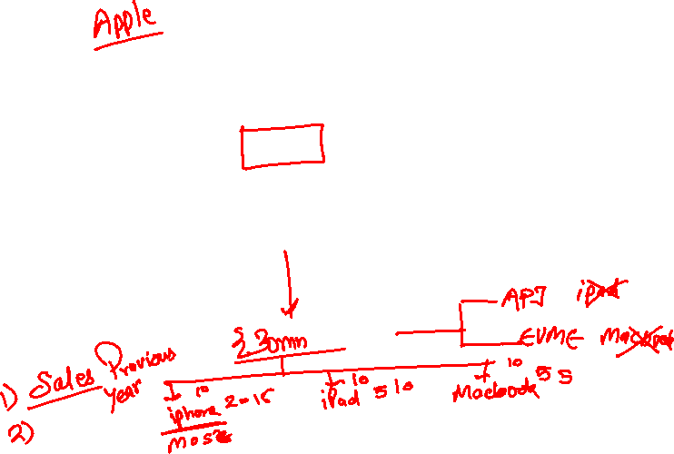
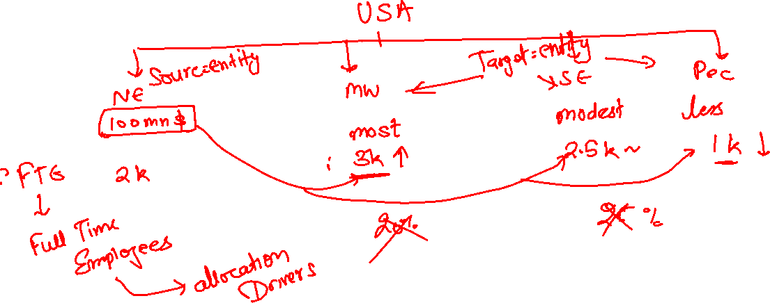
Allocation
An allocation is a distribution but based on a condition. We perform allocation by spreading/distributing data across account dimensions in proportion to a condition is met.
www.anubhavtrainings.com

Slide 4
Objects of an Allocation
Allocation
Step
Rule
1 *
1 *
www.anubhavtrainings.com

Slide 5

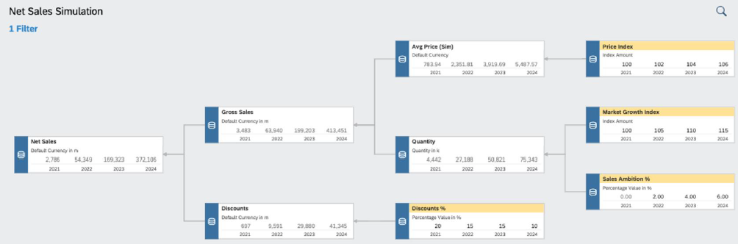
VDT
▪ Value driver trees (VDTs) allow visualizing the composition of a KPI and its contributing factors
▪ A VDT shows how a KPI is calculated from other KPIs and drivers
▪ In SAC, a value driver tree can be used to visualize existing data but also to simulate the impact of driver
changes in real time
▪ In planning, the VDT component can be used to create and simulate different scenarios
▪ Value driver trees are provided as standard story widgets and can be seamlessly integrated into SAC stories
www.anubhavtrainings.com

Slide 6
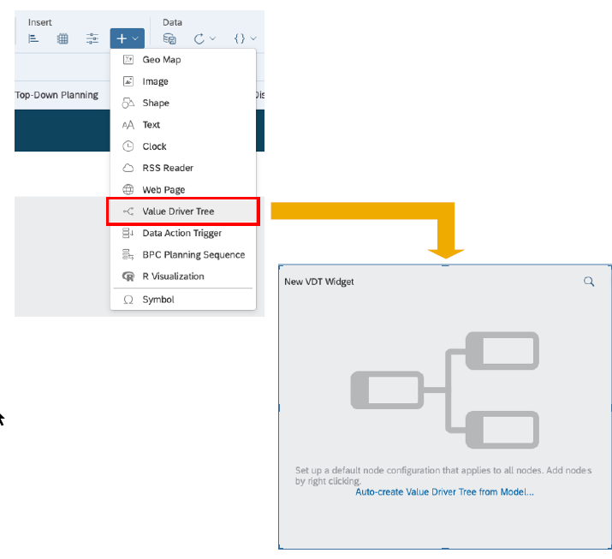
VDT
A value driver tree is a standard widget in the story
▪ VDT widgets can be configured like any other story widget by adding a new component and then using the builder panel
▪ A VDT is based on a data model. The nodes of the tree correspond to KPIs defined in the account dimension
▪ You can automatically generate a value driver tree from an existing model
▪ Alternatively, you can start building the tree from scratch, defining the nodes manually
www.anubhavtrainings.com

Slide 7
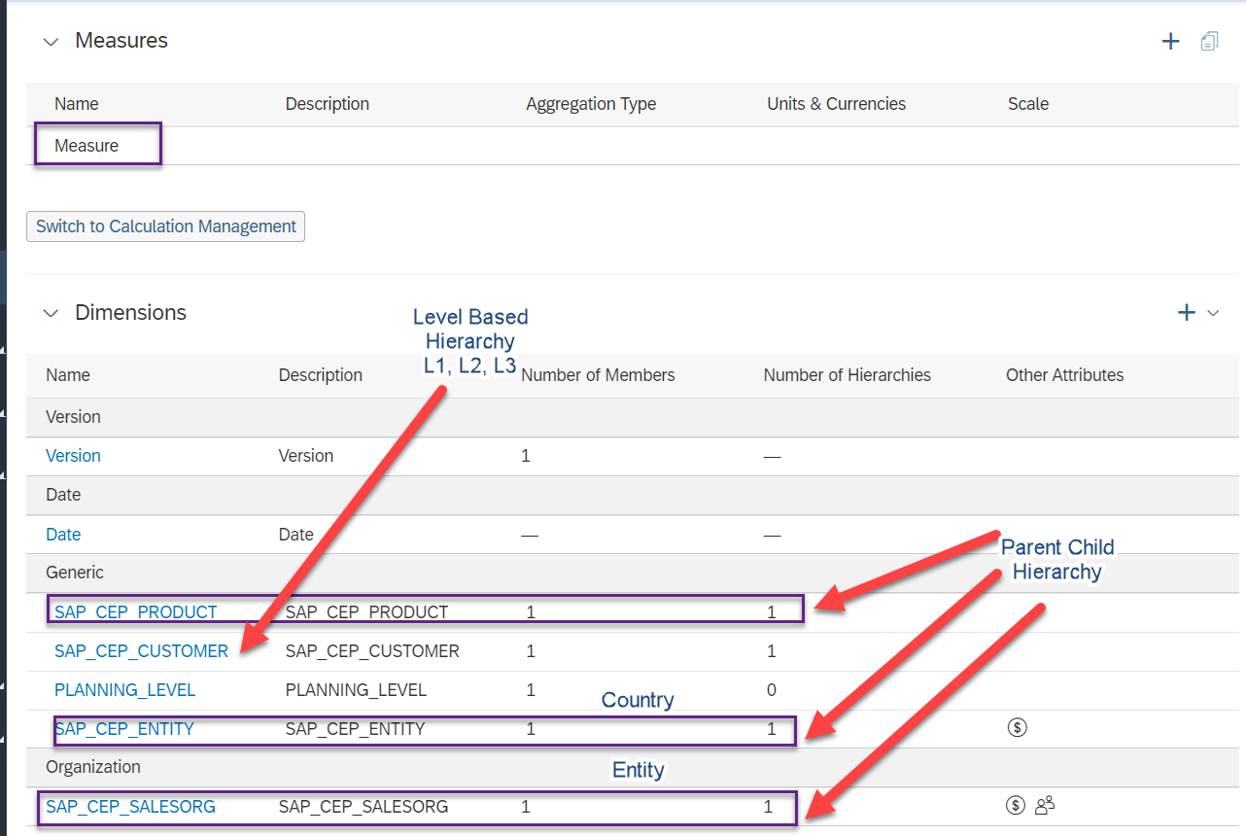

Slide 8
Use case 2
We would like observe the impact of market growth, price index, growth rate on our net revenue. VDT is just a representation of account dimensions connected together. All the calculations related to VDT are going to be done inside the MODEL.
Gross Sales = Quantity (~MarketGrowth, ~SalesAmbition) X Price (~PriceIndex)
Net Sales = gross Sales – Discount (~Discount %)
Price
Price Index
Gross Sales
Growth Rate
Quantity
Net Sales
Sales Ambition %
Discount
Discount %
www.anubhavtrainings.com

Slide 9
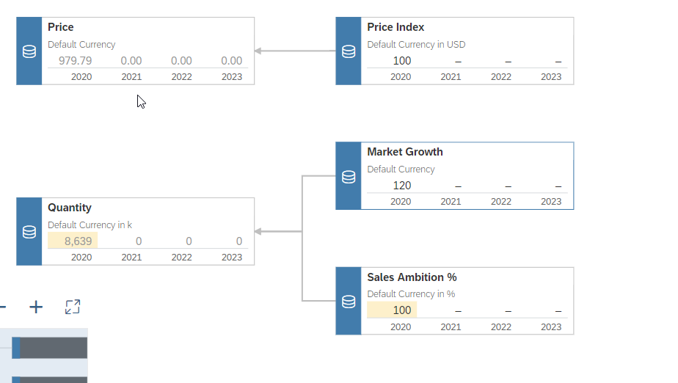
Avg. Price
Price Index
Market Growth Index
Quantity (Sim)
Sales Ambition %

Slide 10
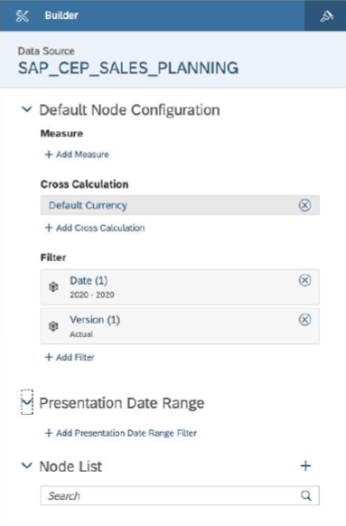
VDT – Node Config
A VDT is built by adding multiple nodes to the Node
List in the builder panel
▪ Each new node will inherit the default node configuration
▪ The configuration can be adjusted for each individual node
▪ The (visual) relation between the nodes is configured via parent/child properties of each node
▪ Parent/child nodes are other existing nodes from the node list
www.anubhavtrainings.com

Slide 11
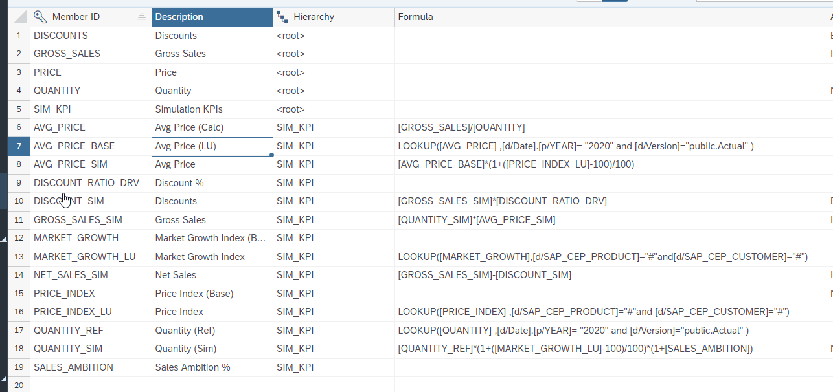
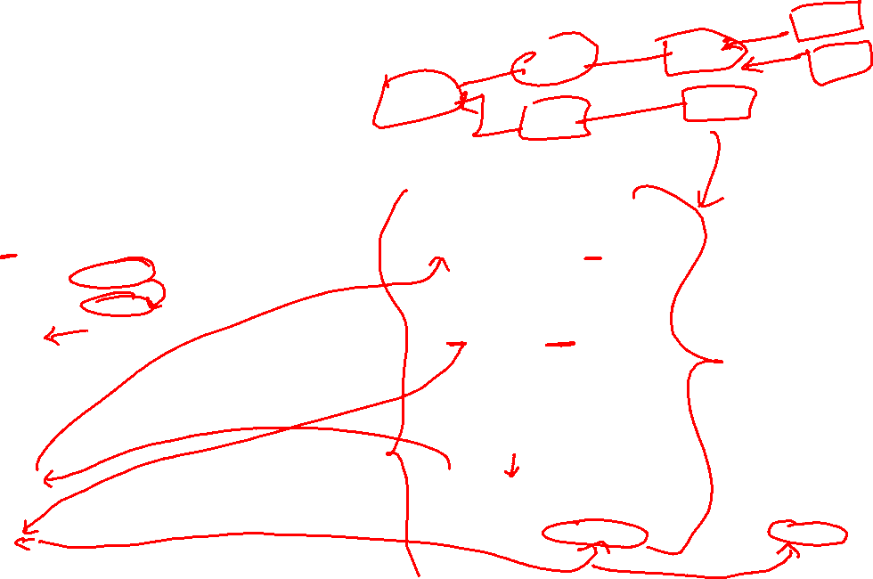

Slide 12
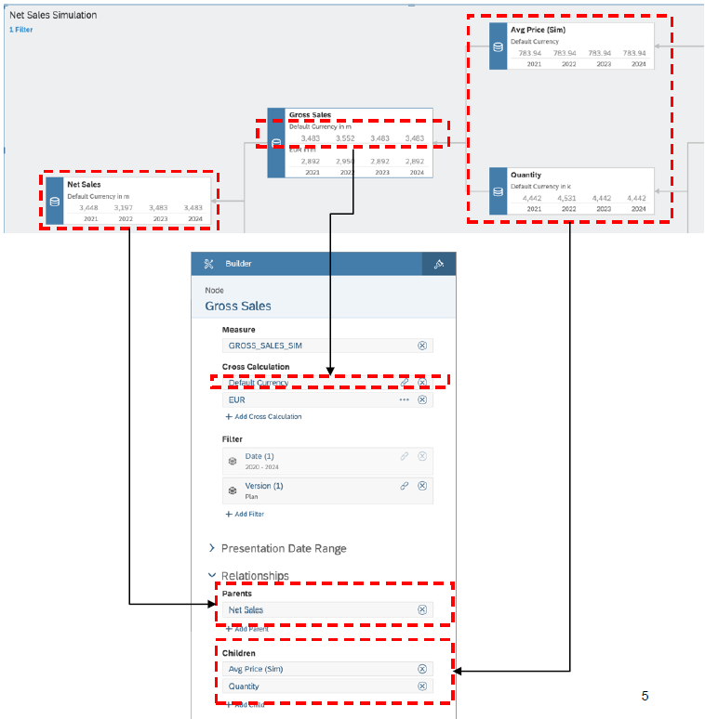
VDT
▪ For each node in the tree, the following parameters
can be configured:
− Measure: KPI to be shown (member of the
account dimension)
− Cross Calculation: Additional measures based
on the base KPI (e.g. different currencies)
− Filter: Scope definition for the KPI
− Presentation Date: Time horizon displayed in
the node
− Relationships: Parent and child nodes in the
tree
www.anubhavtrainings.com

Slide 13
New Model
Classic Model New Model
We have only one measure which is an account measure, that contains all the values combining together.
We cannot add calculated measure while building this model.
The account dimension concept resembles from old BI tools.
Data mapping is old style and tell about the errors only at the final creation steps.
A default measure with name called value gets created.
We can have individual measures along with account dimension also. While building the model, based on preference, we can choose structural priority.
We can add a calculated measure while building the model.
We can develop model which look exactly same as database table in your source system.
We use a enhanced mapping tool which will show a guided flow and unearthed the errors in early phase.
The name of the measure will be same name as column name from the source.
The main purpose is to avoid confusion related to the account dimension in data model for layman.
www.anubhavtrainings.com

Slide 14
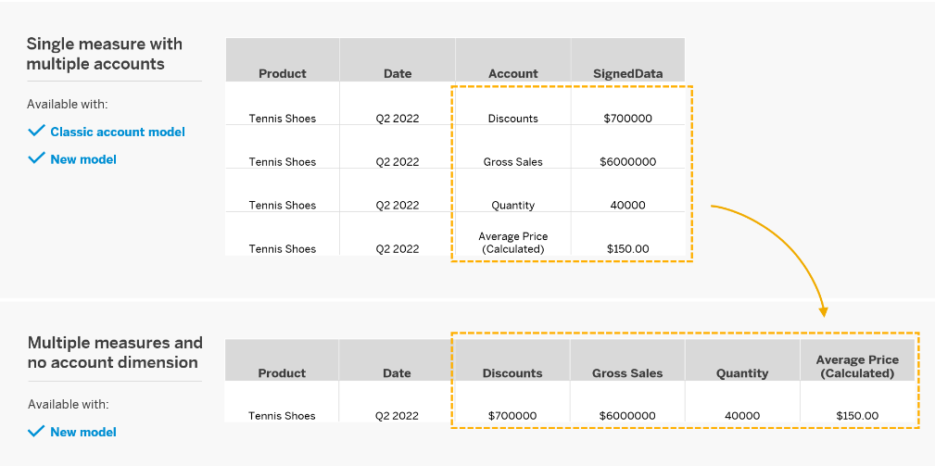
New Model

Slide 15
Data Actions
Used for automating work in SAC planning. They helps end users/planning experts to perform complex tasks with the click of a button.
e.g. if we would like to distribute, allocate, copy, calculate data in planning model, the user needs to do that manually by changing values in report, or needs to have deep understanding of SAC.
You as SAC planning consultant can automate this work with data actions. End user, will just click on a button and the work will be done.
https://help.sap.com/viewer/00f68c2e08b941f081002fd3691d86a7/release/en-US/afe93e3cf1414a7b8419baad11cc066e.html#loioafe93e3cf1414a7b8419baad11cc066e__data_resultlookup
www.anubhavtrainings.com

Slide 16
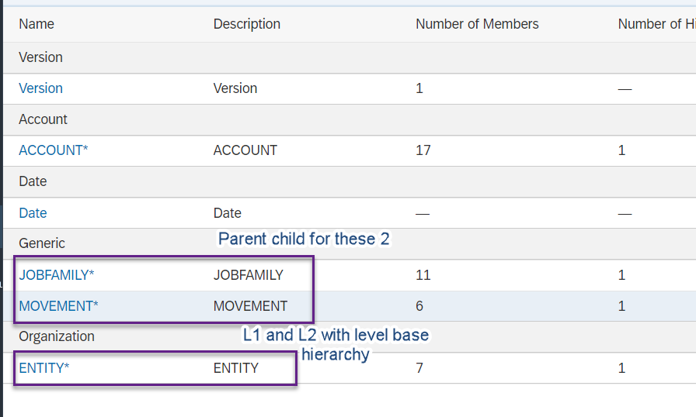

Slide 17
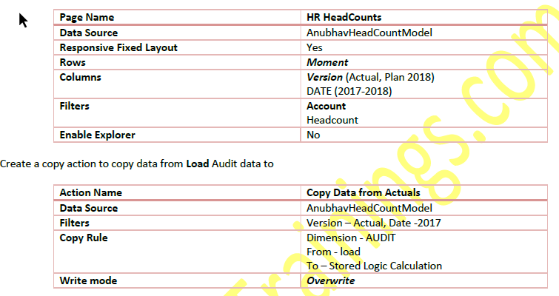
Requirement 1: Copy Data Action
Create Story action to copy the data of 2017 headcount to 2018 plan version
www.anubhavtrainings.com

Slide 18
Requirement 2: Auto calculate headcounts based on Scripting based actions
Finally, we would like to calculate the headcounts based on Hires and Terminations. For calculation, we have to set the opening balance to the ending balance of previous period and Add new hires and subtract the terminations to calculate the final balance. These set of actions needs to be repeated for entire duration on MoM basis.
This is performed using the scripting-based actions, for the ease of writing Anubhav will also show Visual way of writing the script.
CONFIG.TIME_HIERARCHY = CALENDARYEAR
CONFIG.FLIPPING_SIGN_ACCORDING_ACCTYPE = OFF
CONFIG.GENERATE_UNBOOKED_DATA = OFF
MEMBERSET [d/Date] = (BASEMEMBER([d/Date].[h/YQM], "2018"))
FOREACH [d/Date]
DATA([d/MOMENT] = "OPENING") = RESULTLOOKUP([d/MOMENT] = "CLOSING", [d/Date] =
Previous(1))
DATA([d/MOMENT] = "CLOSING") = RESULTLOOKUP([d/MOMENT] = "OPENING") +
RESULTLOOKUP([d/MOMENT] = "HIRES") - RESULTLOOKUP([d/MOMENT] = "TERMINATIONS")
ENDFOR
www.anubhavtrainings.com

Slide 19
What are all the challenges for CEO of a co?
Insight with a simple click
Taking decisions
Planning for future
Real-time information
Resource management
Different perspective at same time
Transparency
Fin
S/4HANA
Procure
Ariba
HR
SuccessFactors
Sales
Hybris Sales Cloud
Marketing
Sales Force
Travel
Concur
www.anubhavtrainings.com

Slide 20
Collaboration
Calendar
Comments
Share
www.anubhavtrainings.com

Slide 21
End of Day 7

Slide 22

Questions

Slide 23

Anurag Bajaj
anurag.bajaj02@gmail.com

